Slide 1


WELCOME TO
SE-232 PRESENTATION
TOPIC OF PRESENTATION - LINUX

Slide 2

TOPIC OF PRESENTATION
Introduction to Linux
Linux Architecture
Linux Distributions
Linux File System and Commands
Linux Security and Applications
SUBMITTED TO
Bohnishikha Halder
LECTURER
Software Engineering Department
Daffodil International University

Slide 3


ABOUT ME
Name: Niher Ronjon Pramanik
ID Number:0242310005341102
Batch Number & SEC:40-D
Department Of Software Engineering
Daffodil International University

Slide 4

WHAT IS LINUX?
Open-source operating system based on Unix.
Developed by Linus Torvalds
in 1991, a student at the
University of Helsinki

Slide 5

KEY FEATURES OF LINUX
FREE AND OPEN SOURCE
SECURE AND STABLE
HIGHLY CUSTOMIZABLE
DIFFERENT DISTRIBUTIONS

Slide 6

WHO USE LINUX?
857,774
Companies using Linux
25.1% MARKET SHARE

Slide 7


8% OF THOSE COMPANIES REVENUES ARE MORE THAN A BILLION DOLLAR!

Slide 8



WHERE IS LINUX USED?
DESKTOP COMPUTERS
ANDROID SMARTPHONES
SERVERS AND CLOUD COMPUTING
IOT DEVICES AND SUPERCOMPUTERS

Slide 9

KERNEL: THE CORE OF LINUX
LINUX ARCHITECTURE
WHAT IS KARNEL?
A kernel is the core part of an operating system. It acts as a bridge between software applications and the hardware of a computer.
TYPES OF KERNEL
Monolithic Kernel
Micro Kernel
Hybrid Kernel

Slide 10
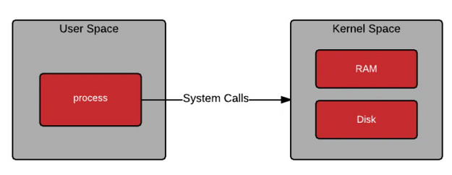
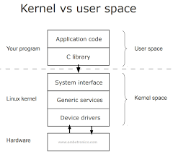
USER SPACE VS KERNEL SPACE
User Space:
Runs applications and utilities.
Limited access to system resources.
If something crashes, it doesn’t affect the entire system.
Kernel Space:
Directly interacts with hardware.
Manages system resources like CPU, memory, and I/O.
A crash here could affect the entire system.

Slide 11




USER SPACE
KERNEL SPACE

Slide 12


ROLE OF SYSTEM LIBRARIES
ROLE OF SHELL
Acts as the interface between the application and the kernel.
GNU C Library (glibc): One of the most important libraries for Linux.
Dynamic Linking: Libraries can be shared among multiple programs to save memory.
A command-line interpreter that allows users to interact with the operating system.
Translates user commands into actions performed by the kernel.

Slide 13
PROCESS AND MEMORY MANAGEMENT
PROCESS MANAGEMENT
MEMORY MANAGEMENT
Multitasking: Linux can handle multiple processes at the same time.
Scheduling: The kernel determines which process gets CPU time.
States of a Process: Running, waiting, or terminated.
A command-line interpreter that allows users to interact with the operating system.
Translates user commands into actions performed by the kernel.
Translates user commands into actions performed by the kernel.

Slide 14
Linux Distributions (Distros)

Slide 15
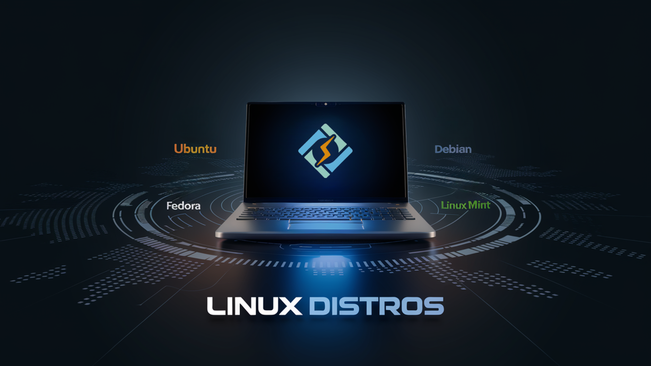
WHAT ARE LINUX DISTROS?
Linux Distros (distributions) are different versions of the Linux operating system, customized to serve a wide range of needs. Each distro includes the Linux kernel, system utilities, applications, and sometimes a desktop environment, tailored for specific purposes or user preferences.

Slide 16
WHY SO MANY DISTROS?
There are many Linux distros because:
Diverse Use Cases: Distros are designed for different environments such as servers, desktops, embedded systems, or security-focused tasks.
User Preferences: Some distros prioritize ease of use, while others focus on control, performance, or flexibility.
Development Focus: Some distros provide cutting-edge software, while others focus on stability for production environments.

Slide 17


UBUNTU
User-friendly, widely used, and great for beginners. Known for ease of use and extensive support.
FEDORA
Cutting-edge technologies, used by developers and tech enthusiasts who want the latest features.

Slide 18


DEBIAN
Stable and widely used on servers, known for its strict adherence to free software principles.
ARCH LINUX
Highly customizable and minimalist, favored by advanced users who want total control over their system

Slide 19
CHOOSING THE RIGHT DISTRO:
Stability: If you need a reliable system (e.g., servers), Debian or CentOS might be good choices.
Customization: Arch Linux or Gentoo allows deep customization and manual configuration.
Cutting-edge Features: Fedora and Arch are excellent for users who want the latest software and technologies.
User-friendliness: Ubuntu or Linux Mint offers a smoother experience, especially for new users.

Slide 20
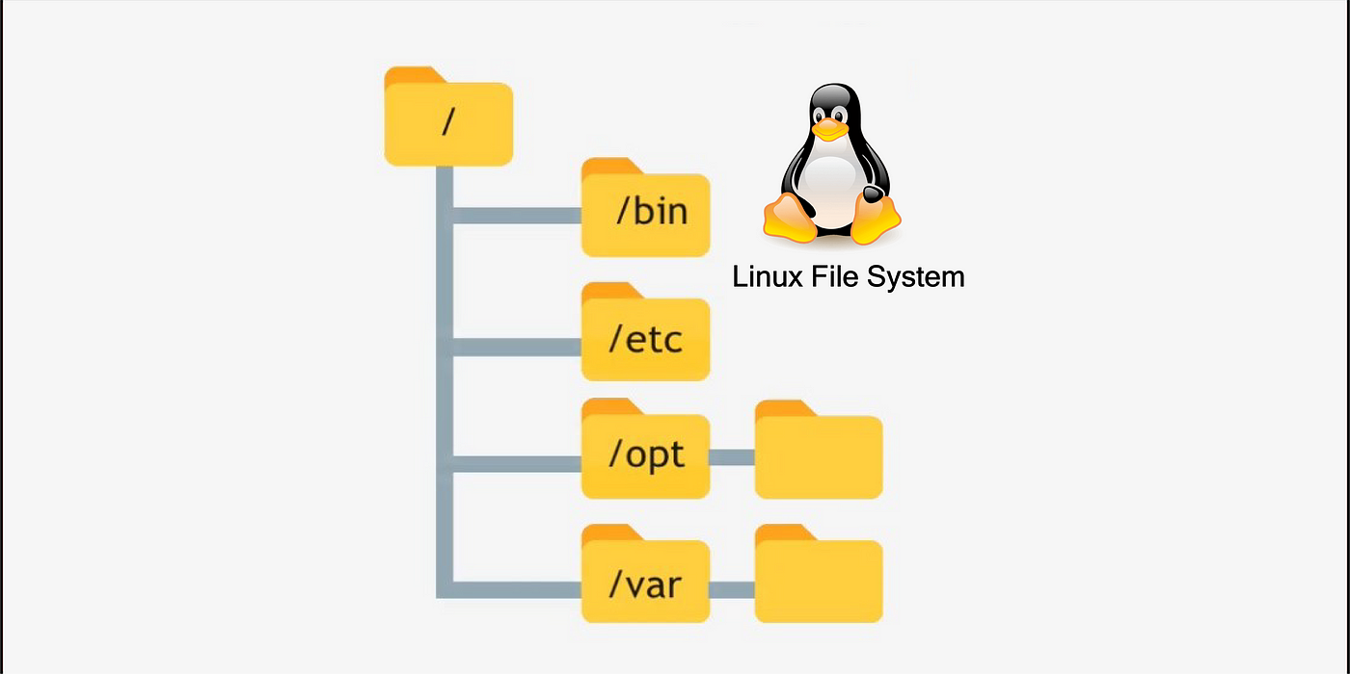
LINUX FILE SYSTEM AND COMMANDS

Slide 21
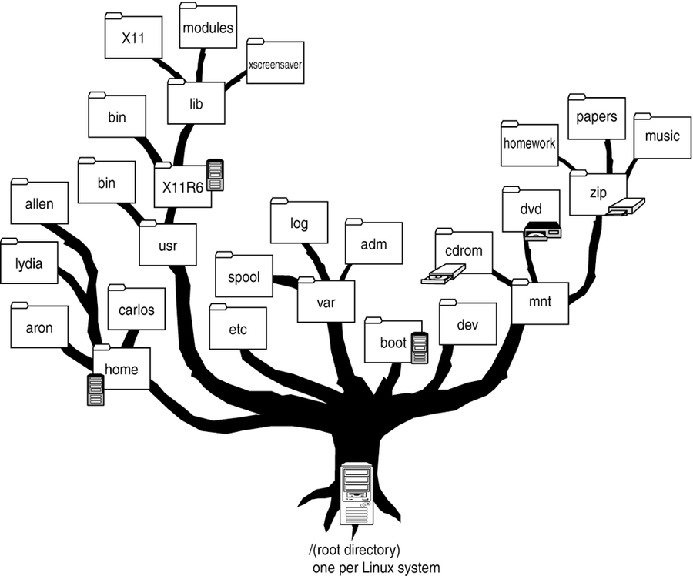
LINUX FILE SYSTEM
The Linux file system is a way of organizing and managing files and directories on a Linux system.
An ordinary file
A directory file
A special file (representing an I/0 device)
A link that points to another file
A socket that is used for interprocess communication

Slide 22
KEY DIRECTORIES
1. / (Root Directory)
Purpose: The root directory is the starting point of the entire Linux file system hierarchy. All files and directories are organized under this directory.
3. /etc (Configuration Files)
Purpose: Contains system-wide configuration files.
2. /home (User Home Directories)
Purpose: Stores personal directories for each user.
4. /bin (Essential User Binaries).
Purpose: Stores essential binaries (commands) used by all users.

Slide 23


FILE PERMISSIONS
Read (r): View file contents.
Write (w): Modify file contents.
Execute (x): Run file as a program.
Permissions are set for:
User (owner)
Group
Others
File permissions in Linux control who can read, write, or execute a file, and are set for the owner (user), group, and others.

Slide 24
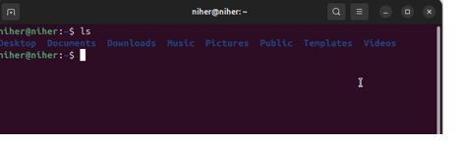
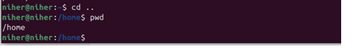
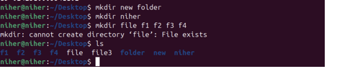
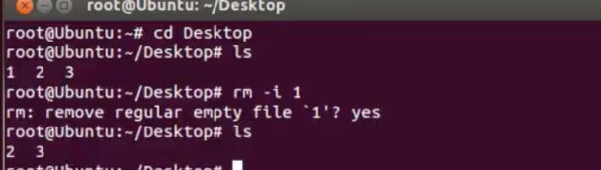
ls: List directory contents.
cd: Change directory.
mkdir: Create a new directory.
rm: Remove files or directories.
sudo: Run commands as superuser.
COMMANDS
Commands in Linux are that allow users to interact with the system, such as managing files, directories, processes, and system resources (e.g., ls, cd, cp, mkdir).

Slide 25


IMPORTANCE OF THE COMMAND LINE
Efficient for automating tasks.
Increases control and productivity.
Direct access to system features.

Slide 26


APPLICATIONS OF LINUX
Servers: Powers most web and cloud servers.
Embedded Systems: Used in devices like routers, smart TVs, and IoT gadgets.
Supercomputers: Runs the majority of the world's supercomputers.
Desktop Use: Used for personal computing with distributions like Ubuntu.
Cybersecurity: Key for penetration testing and hacking tools.
Mobile Devices: Core of Android OS for smartphone
Development: Preferred by programmers and developers.
Research & Education: Ideal for academic and scientific work.

Slide 27


ADVANTAGES OF LINUX
Open Source & Free: Free to use, modify, and distribute.
Performance: Efficient use of system resources, runs well on old and new hardware.
Stability: Rarely crashes; great for long-term use.
Networking: Powers routers, firewalls, and VPN services.
Customization: Highly flexible with many distributions and desktop environments.
Community Support: Large base of helpful resources.
Security: Less prone to malware and viruses; strong user permissions.
Scientific Research: Used in scientific simulations and data analysis.
Privacy: Better control over data security

Slide 28
CONCLUSION
Linux is a secure, customizable operating system that puts users in control, making it a top choice for both personal and professional use. Its adaptability and strong community support drive innovation and reliability across platforms.

Slide 29




REFERANCES
GOOGLE
Wikipedia.com
Youtube.com

Slide 30

THANK YOU

